Slide 1
Hands-On Training
Fundamentals of
Apex Enterprise Patterns

Slide 2

John M. Daniel
Salesforce Architect

Slide 3



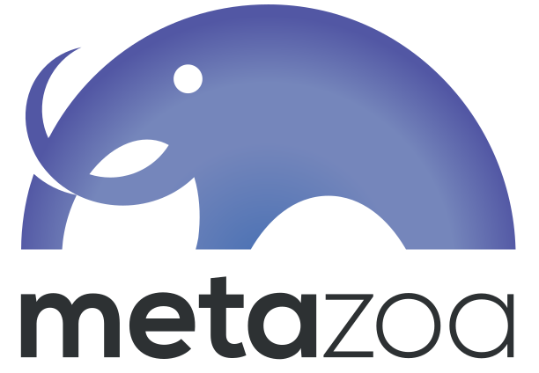


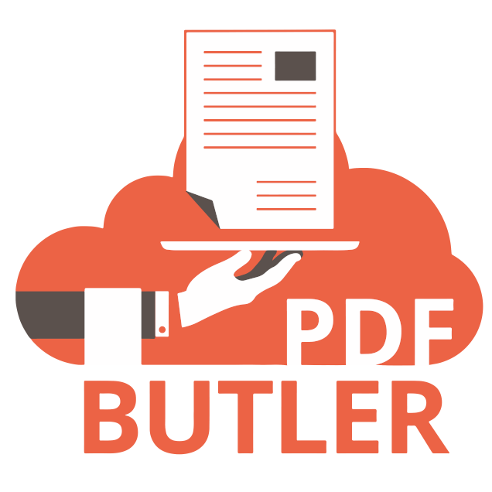







Slide 4
Agenda

Slide 5
Agenda
Get folks setup
Let’s talk about Enterprise Patterns and why we need them
Look at code that could use some help
Swap out those queries for Selectors!
Let’s talk about Domains and centralize core logic
Build an “architectural wall” with Service layer
See how something called a “unit of work” can make our lives better
What else can we do? Application Factory

Slide 6
Get Setup!

Slide 7
Get Setup!
Sample Code repo from GitHub
https://tinyurl.com/SED23HOTFAEP

Slide 8
Let’s talk about Enterprise Patterns
and why we need them

Slide 9
Look at code
that could use some help
Notes:
VSCode – MerchandiseSelector class

Slide 10
MerchandiseController
Issues:
It’s too big!!!!
It violates "single responsibility" pattern (first tenant of SOLID)
  manages various queries -- Account, Product2, etc.
  manages the transaction boundaries of addToOrder and createNewOrder
  manages the gathering and preparing of data to support the Merchandise page

Slide 11
Swap out those queries
for Selectors!!!

Slide 12
Selectors…
Static Queries
Difficult to maintain
Not centralized
  If a new field is needed, developer must change every instance in codebase
Sets up inconsistent SObject creation
  Leads to SObjectException: “SObject row was retrieved via SOQL without querying the requested field”
Violates “Separation of Concerns” principle in that each static query gives responsibility over the query’s formation to the Service or other class hosting it.

Slide 13
Selectors…
Dynamic Queries
more maintainable
Apex Common Selector Pattern make this possible
Classes to mention in the fflib-apex-common project
  fflib_QueryFactory
    Facilitates an object-oriented way construct queries efficiently
  fflib_SObjectSelector
    Abstract base class for all selector pattern classes with in the application
  fflib_ISObjectSelector
    Base interface used by all selector pattern classes
    All individual selector interfaces extend this interface

Slide 14
Selectors…
Minimum setup of a class
Extends fflib_SObjectSelector
Implements the corresponding interface
  Important to support mocking during unit tests via ApexMocks
Implements following methods:
  Schema.SObjectType getSObjectType()
  List<Opportunity> selectById(Set<ID> idSet)
  List<Schema.SObjectField> getSObjectFieldList()
  static IOpportunitiesSelector newInstance()
    This calls the “Application.Selector.newInstance(Opportunity.SObjectType) and casts the instance to the ISelector interface

Slide 15
Selectors…
Let’s write some code
Notes:
Markers
SELECTOR-01
SELECTOR-02

Slide 16
Let’s talk about Domains
and centralize core logic
while we do that

Slide 17
Domains…
What is it?
A class responsible for the business logic specific to a single SObject.
Sometimes viewed as "fine grain services"
It is a wrapper around the records you are working with.
Initialize the domain class with all of the records of that type that you are working with in the current context. This can be one to many records.
It does not manage the persistence of records (see UnitOfWork)
Handles defaulting and validations
Once you have the domain class, you work with a single object, executing logic on the records

Slide 18
Domains…
Classes to mention in the fflib-apex-common project
fflib_SObjectDomain.cls
fflib_ISObjectDomain.cls
Examples in the fflib-apex-common-samplecode project
Opportunities.cls
  Domain class
IOpportunities.cls
  Domain interface
  Important. Because of the loose coupling principles, all outside concerns will work directly with the interface and not the concrete domain class.
  This also key to mocking

Slide 19
Domains…
Minimum setup of a domain class
Extends fflib_SObejctDomain
Implements the corresponding interface
  Important to support mocking during unit tests via ApexMocks
Implements following methods:
  Define class constructor to pass the list of records
  static IOpportunitiesSelector newInstance(List<Opportunity> recordList)
    This calls the “Application.Domain.newInstance(recordList)" and casts the instance to the IDomain interface
  static IOpportunitiesSelector newInstance(Set<Id> recordIdSet)
    This calls the “Application.Domain.newInstance(recordIdSet)" and casts the instance to the IDomain interface

Slide 20
Domains…
Minimum setup of a domain class (…continued)
Override as needed parent class methods
  onApplyDefaults()
  onValidate()
  onValidate(Map<Id,SObject> existingRecords)
  onAfterInsert(), onAfterUpdate(), onBeforeInsert(), onBeforeUpdate(),
Add methods that execute some change or logic to records
  Example: Opportunities.applyDiscount(Decimal discountPercentage, fflib_ISObjectUnitOfWork uow)
  The method DOES NOT pass the records
  They were loaded when the class was instantiated
  If the method will make changes to records that eventually need to be saved, add a “uow” parameter of type fflib_ISObjectUnitOfWork

Slide 21
Domains…
Minimum setup of a domain class (…continued)
Add an inner “Constructor” class
  Needed for the Apex Common trigger handler logic
Trigger Framework hooks
  Apex Commons Trigger framework uses the Domain classes as the “trigger handler” via the inner “Constructor” class
Trigger setup for each SObject is straightforward
  Setup for all events
  Call the fflib_SObjectDomain’s “triggerHandler” method with the appropriate domain class

Slide 22
Domains…
Let’s write some code
Notes:
Markers
DOMAIN-01

Slide 23
Build an
“architectural wall”
with Service layer

Slide 24
Services…
What is it?
A class responsible for aggregating the logic across multiple SObjects
Sometimes viewed as a “coarse-grained service"
This is the traditional “Service Tier Contract” boundary
All Presentation or “client-tier” logic calls the Service Tier logic
  Typically, the "client-tier” logic only calls a single Service method per transaction
Becomes the DML Transaction boundary by utilizing a UnitOfWork (see UnitOfWork pattern)
Classes to mention in the fflib-apex-common project
No core classes needed from the Apex Commons framework
This is a programming convention of Salesforce Platform Enterprise Patterns

Slide 25
Services…
Default set of classes to create for each service
Referring to the example Opportunities Service
  OpportunitiesService
    This is the service facade
  IOpportunitiesService
    This is the service interface
    Service Tier contract is defined at this level
  OpportunitiesServiceImpl
    This is the concrete service implementation
  OpportunitiesServiceTest
  OpportunitiesServiceException

Slide 26
Services…
Minimum setup for service facade class
All methods are bulkified
  Record id parameters are Sets of ID
  All methods are static
Private static IOrdersService() method
  This calls the “Application.Service.newInstance(IOrdersService.class)” method and casts the instance to the service interface
Minimum setup for service interface class
Simple interface with specific methods
Methods defined mirror those found in service facade
Minimum setup for service implementation class
Implements the service interface class

Slide 27
Services…
Let’s write some code
Notes:
Markers
SERVICE-01

Slide 28
See how something called a “unit of work” can make our lives better

Slide 29
Unit Of Work…
What is it?
A “utility” class focused on
  Optimizing DML interactions with the Database layer
  Providing transactional control for the Service Layer
  Simplifying the complex code usually constructed to manage bulkified DML operations
  Managing the “plumbing” needed to save parent-child data relationships
Used within a service method but passed to domain methods as needed.
The UOW manages all DML transactions and rollbacks for all Service Layer logic
Using an instance of UOW, you can register new records, modified/dirty records, and register records that need to be deleted.
Once all records and changes are collected, the “commitWork()” method is called to begin DML transactions.

Slide 30
Unit Of Work…
UOW manages relationships between parent and child records. See fflib-apex-common-samplecode project regarding these references
Since the UOW only holds records until the end of the Service method and the call to the “commitWork()” method, it needs to maintain the “connection” between parent and child records.
The “registerRelationship” series of methods accomplish this.
Reference line 54 of the InvoicingServiceTest class.
  The parent Opportunity record is registered at line 39 …but not saved to database yet
  Each of the child OpportunityLineItem records are
    Registered as new records to be saved at line 55
    Related to the parent Opportunity record at line 54 using the “registerRelationship” method
During the “commitWork()” method execution, the UOW saves the parent Opportunity records, maintains a link to the new opportunity record id, and then adds that parent record id to the child OpportunityLineItem records before saving those new records.

Slide 31
Unit Of Work…
Let’s write some code
Notes:
Markers
UOW-01

Slide 32
What else can we do?
How about an “Application Factory”?

Slide 33
Application Factory…
What is it?
This is the piece that orchestrates the assembly and mappings of the loosely coupled services, domains, and selectors
All instantiations of selectors, domains, services, and UOWs are handled by this class
A single Application class is defined which statically maps …
  SObjects to selector classes
  SObjects to domain classes
  Service Interfaces to Service Implementations
  SObjects that the UOW is designed to work with and listed in DML execution order

Slide 34
Application Factory…
Minimum setup of Application Factory class
Simple class
Defines four static final methods
  Selector
    Equals new fflib_Application.SelectorFactory instance with "Map<SObjectType, Type>” as the constructor parameter
    The Map<SObjectType, Type> maps between SObject and the associated selector class
  UnitOfWork
    Equals new fflib_Application.UnitOfWorkFactory instance with "List<SObjectType>” as the constructor parameter
    The List<SObjectType> represents the SObjects that the UOW is designed to work with and listed in DML execution order

Slide 35
Application Factory…
Minimum setup of Application Factory class
Defines four static final methods (…continued)
  Service
    Equals new fflib_Application.ServiceFactory instance with "Map<Type, Type>” as the constructor parameter
    The Map<Type, Type> represents the mapping between Service Interfaces and Service Implementation classes
  Domain
    Equals new fflib_Application.DomainFactory instance with two constructor parameters
      Reference to the Application.Selector factory
      Map<SObjectType, Type>
    The Map<SObjectType, Type> maps between SObject and the associated domain class

Slide 36
Application Factory…
Let’s write some code
Notes:
Markers
APPFACTORY-01

Slide 37
But wait!
There’s more!

Slide 38
Want to learn more???
Webinars
“Apex Enterprise Patterns” on the ApexHours YouTube Channel
  https://www.apexhours.com/apex-enterprise-patterns/
Dreamforce 14 session: Advanced Apex Enterprise Patterns
  https://www.youtube.com/watch?v=BLXp0ZP0cF0
  Deck from talk — https://docs.google.com/file/d/0B6brfGow3cD8RVVYc1dCX2s0S1E

Slide 39
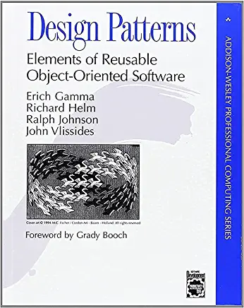
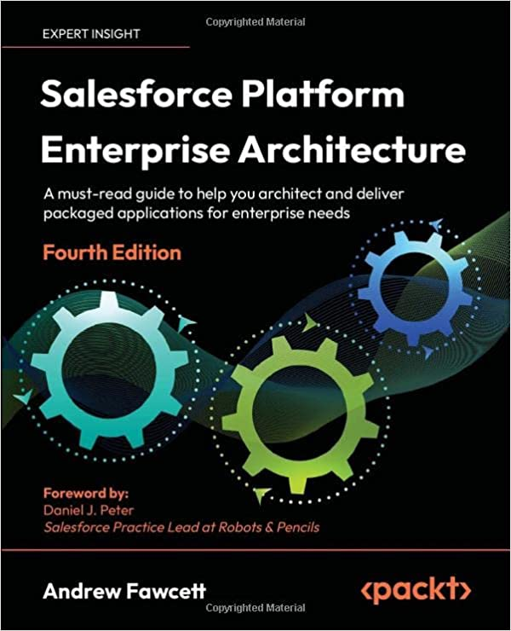
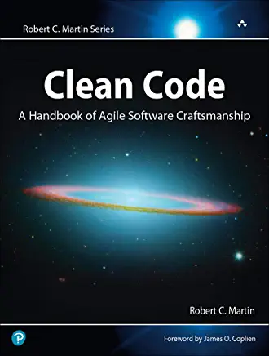
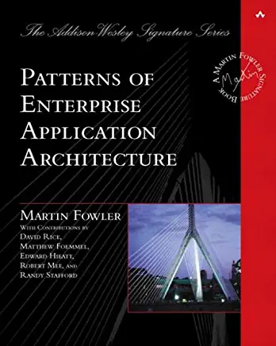
Want to learn more???
Book References on Enterprise Patterns Concepts
Design Patterns, “Gang Of Four”
Patterns of Enterprise Architecture, Martin Fowler
Clean Code, Robert "Uncle Bob" Martin
Salesforce Platform Enterprise Architecture, 4th edition, Andrew Fawcett

Slide 40
Want to learn more???
Blogs
Apex Enterprise Patterns — Separation of Concerns
  https://andyinthecloud.com/2012/11/16/apex-enterprise-patterns-separation-of-concerns/
Apex Enterprise Patterns — Selector Layer
  https://andyinthecloud.com/2013/09/09/apex-enterprise-patterns-selector-layer/
Apex Enterprise Patterns — Domain Layer
  https://andyinthecloud.com/2013/04/24/apex-enterprise-patterns-domain-layer/
Apex Enterprise Patterns — Service Layer
  https://andyinthecloud.com/2013/02/11/apex-enterprise-patterns-service-layer/
Apex Enterprise Patterns — Unit Of Work
  http://andyinthecloud.com/2013/06/09/managing-your-dml-and-transactions-with-a-unit-of-work/
  http://andyinthecloud.com/2014/07/17/doing-more-work-with-the-unit-of-work/
Apex Enterprise Patterns — FinancialForce Apex Common Updates
  https://andyinthecloud.com/2014/06/28/financialforce-apex-common-updates/

Slide 41
Want to learn more???
Trailhead Modules
Salesforce Lightning Platform Enterprise Architecture
Apex Enterprise Patterns: Service Layer
  https://trailhead.salesforce.com/content/learn/modules/apex_patterns_sl
Apex Enterprise Patterns: Domain & Selector Layers
  https://trailhead.salesforce.com/en/content/learn/modules/apex_patterns_dsl

Slide 42
Want to learn more???
Frameworks and Sample Code Repos
FFLIB Apex Common https://github.com/apex-enterprise-patterns/fflib-apex-common
FFLIB Apex Common Samplecode https://github.com/apex-enterprise-patterns/fflib-apex-common-samplecode
FFLIB Apex Mocks https://github.com/apex-enterprise-patterns/fflib-apex-mocks
Apex Enterprise Patterns Open Source Frameworks https://github.com/apex-enterprise-patterns

Slide 43
That’s all folks!

